Slide 1
DTS207TC Database Development and Design
Lecture 3
Chap 5 Advanced SQL
Di Zhang, Autumn 2025
Page titles with * will not be assessed
Notes:
I am very happy to have the opportunity to meet with you all in this course.

Slide 2
Outline
Accessing SQL From a Programming Language
Functions and Procedures
Triggers
Recursive Queries

Slide 3

Accessing SQL from a Programming Language
A database programmer must have access to a general-purpose programming language for at least two reasons
Not all queries can be expressed in SQL, since SQL does not provide the full expressive power of a general-purpose language.
Non-declarative actions -- such as printing a report, interacting with a user, or sending the results of a query to a graphical user interface -- cannot be done from within SQL.
1
The content of this section of the textbook is outdated. JDBC/ODBC is not commonly used in Python. Python usually uses its language-specific protocol DB-API.

Slide 4
*Other interfaces of DB
DB without SQL
  HTTP: postgres-meta
  Structured text: GraphQL
  NLP: sequel.sh

Slide 5
Functions and Procedures
Functions and procedures allow “business logic” to be stored in the database and executed from SQL statements.
These can be defined either by the procedural component of SQL or by an external programming language such as Python.

Slide 6
Declaring SQL Functions
Define a function that, given the name of a department, returns the count of the number of instructors in that department.
create function dept_count (dept_name varchar(20))
returns integer
begin
declare d_count integer;
select count (* ) into d_count
from instructor
where instructor.dept_name = dept_name
return d_count;
end
The function dept_count can be used to find the department names and budget of all departments with more that 12 instructors.
select dept_name, budget
from department
where dept_count (dept_name ) > 12

Slide 7
Table Functions
The SQL standard supports functions that can return tables as results; such functions are called table functions
Example: Return all instructors in a given department
create function instructor_of (dept_name char(20))
returns table (
ID varchar(5),
name varchar(20),
dept_name varchar(20),
salary numeric(8,2))
return table
(select ID, name, dept_name, salary
from instructor
where instructor.dept_name = instructor_of.dept_name)
Usage
select *
from table (instructor_of ('Music'))

Slide 8
SQL Procedures
The dept_count function could instead be written as procedure:
create procedure dept_count_proc (in dept_name varchar(20),
out d_count integer)
begin
select count(*) into d_count
from instructor
where instructor.dept_name = dept_count_proc.dept_name
end
The keywords in and out are parameters that are expected to have values assigned to them and parameters whose values are set in the procedure in order to return results.
Procedures can be invoked either from an SQL procedure or from embedded SQL, using the call statement.
declare d_count integer;
call dept_count_proc( 'Physics', d_count);

Slide 9
SQL Procedures (Cont.)
Procedures and functions can be invoked also from dynamic SQL
SQL allows more than one procedure of the so long as the number of arguments of the procedures with the same name is different.
The name, along with the number of arguments, is used to identify the procedure.
2
Notes:
/* ------------------------------------------------------------------
0. Set-up
-------------------------------------------------------------------*/
DROP SCHEMA IF EXISTS demo_5 CASCADE;
CREATE SCHEMA demo_5;
SET search_path = demo_5, public;
/* two base tables used in the examples */
CREATE TABLE department (
dept_name VARCHAR(20) PRIMARY KEY,
budget NUMERIC(12,2) NOT NULL
);
CREATE TABLE instructor (
id VARCHAR(5) PRIMARY KEY,
name VARCHAR(20) NOT NULL,
dept_name VARCHAR(20) REFERENCES department,
salary NUMERIC(8,2) NOT NULL
);
/* tiny sample so that “> 12” can still return something */
INSERT INTO department VALUES
('Physics', 1000000),
('Music', 500000),
('CS', 2000000);
INSERT INTO instructor(id, name, dept_name, salary)
SELECT
'I'||lpad(seq::text,3,'0'),
'Prof-'||seq,
CASE WHEN seq%14=0 THEN 'Physics'
WHEN seq%5=0 THEN 'Music'
ELSE 'CS' END,
70000+random()*50000
FROM generate_series(1,40) seq; -- 40 rows: CS=24, Physics=3, Music=13
/* ------------------------------------------------------------------
1. Scalar function dept_count (original example)
-------------------------------------------------------------------*/
CREATE OR REPLACE FUNCTION dept_count(p_dept_name VARCHAR(20))
RETURNS INTEGER
LANGUAGE plpgsql
AS $$
DECLARE
d_count INTEGER;
BEGIN
SELECT COUNT(*) INTO d_count
FROM instructor
WHERE instructor.dept_name = p_dept_name;
RETURN d_count;
END;
$$;
/* usage */
SELECT dept_name, budget
FROM department
WHERE dept_count(dept_name) > 2; -- returns CS and Music
/* ------------------------------------------------------------------
2. Table function instructor_of (returns a setof rows)
-------------------------------------------------------------------*/
CREATE OR REPLACE FUNCTION instructor_of(p_dept_name VARCHAR(20))
RETURNS TABLE (
id VARCHAR(5),
name VARCHAR(20),
dept_name VARCHAR(20),
salary NUMERIC(8,2)
)
LANGUAGE sql
AS $$
SELECT id, name, dept_name, salary
FROM instructor
WHERE instructor.dept_name = p_dept_name;
$$;
/* usage */
SELECT *
FROM instructor_of('Music'); -- 13 rows
/* ------------------------------------------------------------------
3. Stored procedure dept_count_proc (IN / OUT parameters)
-------------------------------------------------------------------*/
CREATE OR REPLACE PROCEDURE dept_count_proc(
IN p_dept_name VARCHAR(20),
OUT p_d_count INTEGER)
LANGUAGE plpgsql
AS $$
BEGIN
SELECT COUNT(*) INTO p_d_count
FROM instructor
WHERE instructor.dept_name = p_dept_name;
END;
$$;
/* invocation from PL/pgSQL block (anonymous code) */
DO $$
DECLARE
v_count INTEGER;
BEGIN
CALL dept_count_proc('Physics', v_count);
RAISE NOTICE 'Physics has % instructors', v_count;
END;
$$;
/* ------------------------------------------------------------------
4. Dynamic-SQL demo (build & run any statement at run time)
-------------------------------------------------------------------*/
CREATE OR REPLACE FUNCTION dynamic_instructor_cnt(
p_dept_name VARCHAR(20)
)
RETURNS INTEGER
LANGUAGE plpgsql
AS $$
DECLARE
v_sql TEXT;
v_cnt INTEGER;
BEGIN
v_sql := format(
'SELECT COUNT(*) FROM instructor WHERE dept_name = %L',
p_dept_name);
EXECUTE v_sql INTO v_cnt;
RETURN v_cnt;
END;
$$;
/* quick test */
SELECT dynamic_instructor_cnt('CS'); -- 24
/* ------------------------------------------------------------------
5. Overloading demo (same name, different arity)
-------------------------------------------------------------------*/
CREATE OR REPLACE FUNCTION add_instructor(
p_id VARCHAR(5),
p_name VARCHAR(20),
p_dept VARCHAR(20)
)
RETURNS VOID
LANGUAGE sql
AS $$
INSERT INTO instructor(id, name, dept_name, salary)
VALUES (p_id, p_name, p_dept, 0);
$$;
CREATE OR REPLACE FUNCTION add_instructor(
p_id VARCHAR(5),
p_name VARCHAR(20),
p_dept VARCHAR(20),
p_sal NUMERIC(8,2)
)
RETURNS VOID
LANGUAGE sql
AS $$
INSERT INTO instructor(id, name, dept_name, salary)
VALUES (p_id, p_name, p_dept, p_sal);
$$;
/* both variants coexist */
SELECT add_instructor('I999', 'New-1', 'Music');
SELECT add_instructor('I998', 'New-2', 'CS', 95000);
/* ------------------------------------------------------------------
6. Clean-up (optional)
-------------------------------------------------------------------*/
-- DROP SCHEMA demo_5 CASCADE;

Slide 10
Language Constructs for Procedures & Functions
SQL supports constructs that gives it almost all the power of a general-purpose programming language.
  Warning: most database systems implement their own variant of the standard syntax below.
Compound statement: begin … end,
  May contain multiple SQL statements between begin and end.
  Local variables can be declared within a compound statements
While and repeat statements:
  while boolean expression do
    sequence of statements ;
  end while
  repeat
    sequence of statements ;
  until boolean expression
  end repeat

Slide 11
Language Constructs (Cont.)
For loop
  Permits iteration over all results of a query
Example: Find the budget of all departments
declare n integer default 0;
for r as
select budget from department where dept_name = 'Music'
do
set n = n + r.budget
end for

Slide 12
Language Constructs – if-then-else
Conditional statements (if-then-else)
if boolean expression
then statement or compound statement
elseif boolean expression
then statement or compound statement
else statement or compound statement
end if

Slide 13
Example procedure
Registers student after ensuring classroom capacity is not exceeded
  Returns 0 on success and -1 if capacity is exceeded
Signaling of exception conditions, and declaring handlers for exceptions
declare out_of_classroom_seats condition
declare exit handler for out_of_classroom_seats
begin
…
end
The statements between the begin and the end can raise an exception by executing “signal out_of_classroom_seats”
The handler says that if the condition arises he action to be taken is to exit the enclosing the begin end statement.
3

Slide 14
External Language Routines
SQL allows us to define functions in a programming language such as Java, C#, C or C++.
  Can be more efficient than functions defined in SQL, and computations that cannot be carried out in SQL\can be executed by these functions.
Declaring external language procedures and functions
create procedure dept_count_proc(in dept_name varchar(20),
out count integer)
language C
external name '/usr/avi/bin/dept_count_proc'
create function dept_count(dept_name varchar(20))
returns integer
language C
external name '/usr/avi/bin/dept_count'

Slide 15
External Language Routines (Cont.)
Benefits of external language functions/procedures:
  more efficient for many operations, and more expressive power.
Drawbacks
  Code to implement function may need to be loaded into database system and executed in the database system’s address space.
    risk of accidental corruption of database structures
    security risk, allowing users access to unauthorized data
  There are alternatives, which give good security at the cost of potentially worse performance.
  Direct execution in the database system’s space is used when efficiency is more important than security.

Slide 16
*Other interfaces of DB
SQL without DB
  SQL on Pandas
  SQL for data flows: Flink SQL
  SQL for ML: https://sql-machine-learning.github.io/
4

Slide 17
Triggers
A trigger is a statement that is executed automatically by the system as a side effect of a modification to the database.
To design a trigger mechanism, we must:
  Specify the conditions under which the trigger is to be executed.
  Specify the actions to be taken when the trigger executes.
Triggers introduced to SQL standard in SQL:1999, but supported even earlier using non-standard syntax by most databases.
  Syntax illustrated here may not work exactly on your database system; check the system manuals

Slide 18
Triggering Events and Actions in SQL
Triggering event can be insert, delete or update
Triggers on update can be restricted to specific attributes
  For example, after update of takes on grade
Values of attributes before and after an update can be referenced
  referencing old row as : for deletes and updates
  referencing new row as : for inserts and updates
Triggers can be activated before an event, which can serve as extra constraints. For example, convert blank grades to null.
create trigger setnull_trigger before update of takes
referencing new row as nrow
for each row
when (nrow.grade = ' ')
begin atomic
set nrow.grade = null;
end;

Slide 19
Trigger to Maintain credits_earned value
create trigger credits_earned after update of takes on (grade)
referencing new row as nrow
referencing old row as orow
for each row
when nrow.grade <> 'F' and nrow.grade is not null
and (orow.grade = 'F' or orow.grade is null)
begin atomic
update student
set tot_cred= tot_cred +
(select credits
from course
where course.course_id= nrow.course_id)
where student.id = nrow.id;
end;

Slide 20
Statement Level Triggers
Instead of executing a separate action for each affected row, a single action can be executed for all rows affected by a transaction
  Use for each statement instead of for each row
  Use referencing old table or referencing new table to refer to temporary tables (called transition tables) containing the affected rows
  Can be more efficient when dealing with SQL statements that update a large number of rows
5

Slide 21
When Not To Use Triggers
Triggers were used earlier for tasks such as
  Maintaining summary data (e.g., total salary of each department)
  Replicating databases by recording changes to special relations (called change or delta relations) and having a separate process that applies the changes over to a replica
There are better ways of doing these now:
  Databases today provide built in materialized view facilities to maintain summary data
  Databases provide built-in support for replication
Encapsulation facilities can be used instead of triggers in many cases
  Define methods to update fields
  Carry out actions as part of the update methods instead of
  through a trigger

Slide 22
When Not To Use Triggers (Cont.)
Risk of unintended execution of triggers, for example, when
  Loading data from a backup copy
  Replicating updates at a remote site
  Trigger execution can be disabled before such actions.
Other risks with triggers:
  Error leading to failure of critical transactions that set off the trigger
  Cascading execution

Slide 23
*Event-driven Programming
In computer programming, event-driven programming also known as event-based programming is a programming method in which the flow of the program is determined by sensor outputs or user actions (such as mouse clicks, key presses) or by messages from other programs or threads running on the computer.
6
Notes:
Method And Apparatus For Testing On-line Services

Slide 24
*Trigger is an instance of event-driven
Database trigger is nothing more than “an event-driven callback living inside the database kernel”.
Event-driven architecture (EDA) | Database trigger
Event source | DML/DDL/database-level events on a table or column (INSERT, UPDATE, DELETE, CREATE, LOGON …)
Event object | The “transition table” or :OLD / :NEW pseudo-records generated by the kernel for that change
Event bus / dispatcher | The trigger manager, which hands control to the bound trigger when a given event point fires
Listener / handler | The PL/SQL, T-SQL, pgSQL, etc. procedural code you write inside the trigger body
Sync vs async | 99 % of triggers run **synchronously** inside the same transaction, but you can also write the event into a queue and let an asynchronous job consume it (Oracle AQ, pgmq, RabbitMQ plug-in …), turning the DB into an “EDA inside the box”
Callback rules | Trigger timing (BEFORE / AFTER / INSTEAD OF), granularity (ROW / STATEMENT), number of invocations—exactly the filtering conditions you specify when registering an event handler

Slide 25

**Why the instruction-driven is always the mainstream?
From the machine's perspective, they are the equivalent. But,...
The human brain has evolved through natural selection and contains specialized cognitive modules that address specific survival and reproductive challenges.
For instance,people typically complete tasks step by step in a certain order.This sequential thinking stems from:
  In hunting activities,focusing on one task and proceeding according to a plan is more conducive to survival.
  Sequential knowledge is repeatable, thus it can be better learned and passed down.
  Humans tend to choose predictable environments and settle in calm areas rather than those with intense changes.

Slide 26
Recursion in SQL
Example: find which courses are a prerequisite, whether directly or indirectly, for a specific course
with recursive rec_prereq(course_id, prereq_id) as (
select course_id, prereq_id
from prereq
union
select rec_prereq.course_id, prereq.prereq_id,
from rec_rereq, prereq
where rec_prereq.prereq_id = prereq.course_id
)
select ∗
from rec_prereq;
This example view, rec_prereq, is called the transitive closure of the prereq relation

Slide 27
The Power of Recursion
Recursive views make it possible to write queries, such as transitive closure queries, that cannot be written without recursion or iteration.
  Intuition: Without recursion, a non-recursive non-iterative program can perform only a fixed number of joins of prereq with itself
    This can give only a fixed number of levels of managers
    Given a fixed non-recursive query, we can construct a database with a greater number of levels of prerequisites on which the query will not work
    Alternative: write a procedure to iterate as many times as required
      See procedure findAllPrereqs in book

Slide 28
The Power of Recursion
Computing transitive closure using iteration, adding successive tuples to rec_prereq
  The next slide shows a prereq relation
  Each step of the iterative process constructs an extended version of rec_prereq from its recursive definition.
  The final result is called the fixed point of the recursive view definition.
Recursive views are required to be monotonic. That is, if we add tuples to prereq the view rec_prereq contains all of the tuples it contained before, plus possibly more

Slide 29
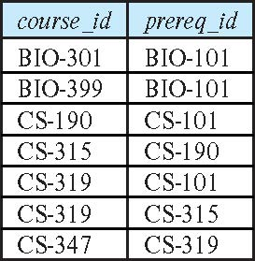
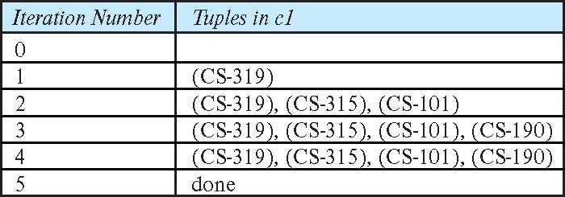
Example of Fixed-Point Computation
7
8
Fixed-Point: No change with iterations

Slide 30
*Recursion
The process in which a function calls itself directly or indirectly is called recursion and the corresponding function is called a recursive function.
A recursive algorithm takes one step toward solution and then recursively call itself to further move. The algorithm stops once we reach the solution.
Since called function may further call itself, this process might continue forever. So it is essential to provide a base case to terminate this recursion process.

Slide 31
*Example: Factorial Numbers
9

Slide 32
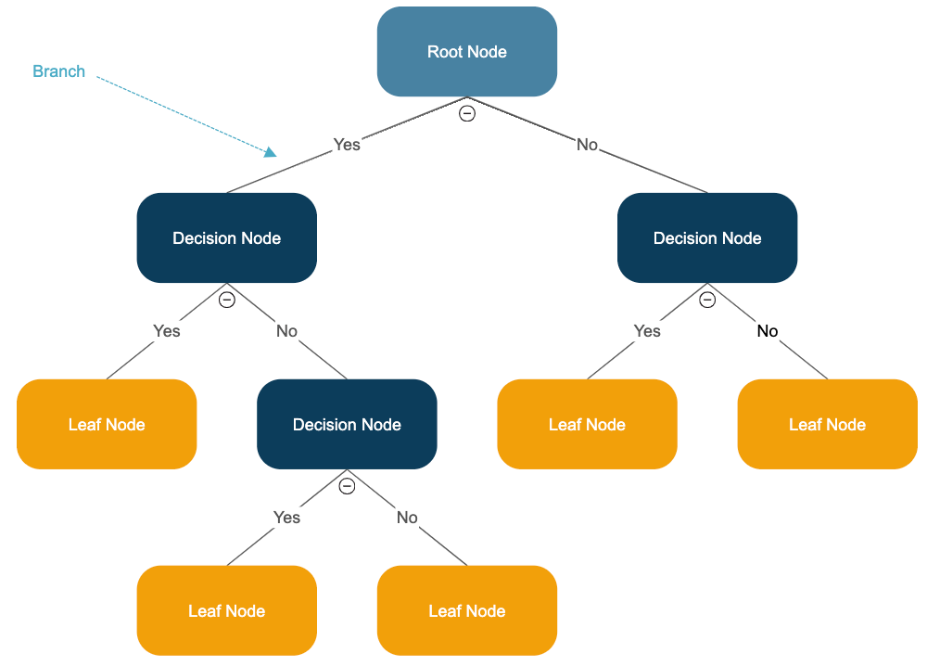
*Example: Decision Tree
10

